Slide 1
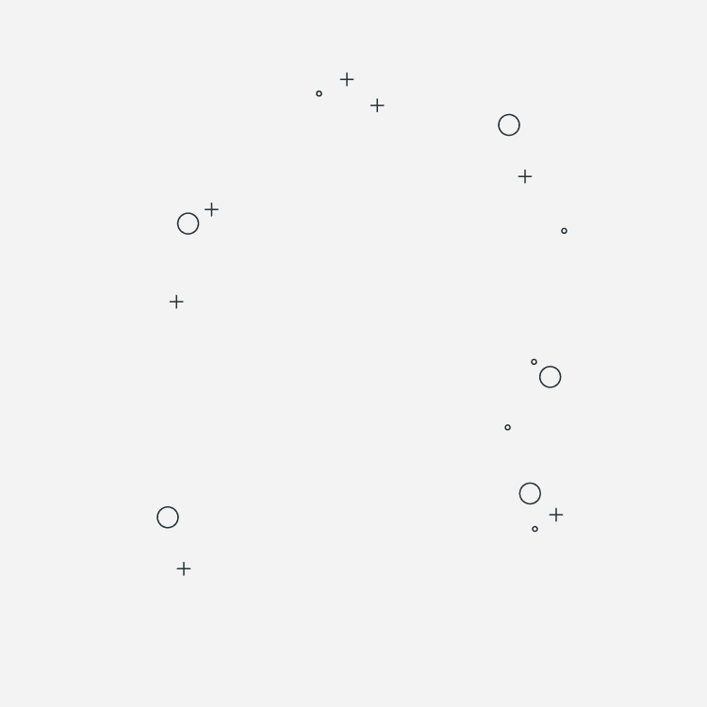
RetinaVision: Deep Learning Insights into Ocular Disease Identification 21AIE312 Deep Learning For Signal And Image Processing END SEMESTER PROJECT HEMA RADHIKA(CB.EN.U4AIE21050) BATCH-A

Slide 2
INTRODUCTION:
What is Ocular Disease Recognition?
The importance of ocular disease recognition cannot be overstated. Visual impairment and blindness resulting from undiagnosed or untreated ocular diseases have profound implications on individuals' quality of life and socioeconomic well-being. Moreover, the economic burden associated with vision loss is substantial, affecting healthcare systems and society at large. Therefore, developing efficient and accurate methods for ocular disease recognition is paramount to improving patient outcomes and reducing the societal impact of these conditions
Objective of the Project:
The primary objective of our project is to leverage deep learning techniques to develop a robust and accurate system for ocular disease recognition. By harnessing the power of deep neural networks, we aim to automate the process of diagnosing ocular diseases from retinal images with high precision and efficiency. Our goal is to contribute to the advancement of ocular healthcare by providing healthcare professionals with an effective tool for early detection and management of ocular diseases.

Slide 3
MOTIVATION OF THE PROJECT:
Public Health Impact
Challenges in Diagnosis
Potential of Deep Learning
Benefits of Automation

Slide 4
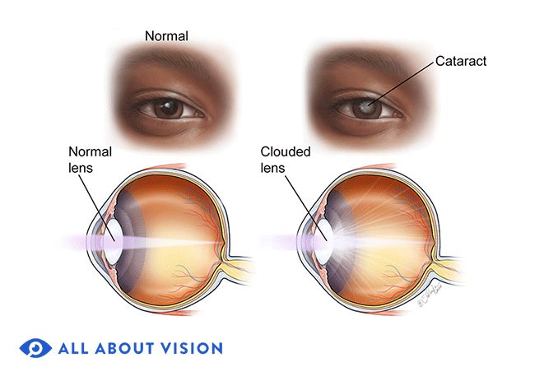
Objectives of the Project:
Evaluate Perfomance
Comparison of Models
Optimize Pretrained Models
Customize Architecture
Implementation of MIRNet

Slide 5
DATASET DESCRIPTION:
ODIR is a structured ophthalmic database that contains data from 5,000 patients. The dataset contains age information, colour fundus pictures of both the left and right eyes, and diagnostic keywords provided by clinicians.
The dataset is a real-life collection of patient information obtained by Shanggong Medical Technology Co., Ltd. from hospitals and medical centres around China. Fundus photos were taken with several cameras available on the market, including Canon, Zeiss, and Kowa, resulting in varying image resolutions.
Our dataset is unique in that it includes many ophthalmic illnesses, as opposed to many other fundus picture databases that only cover one ailment.

Slide 6
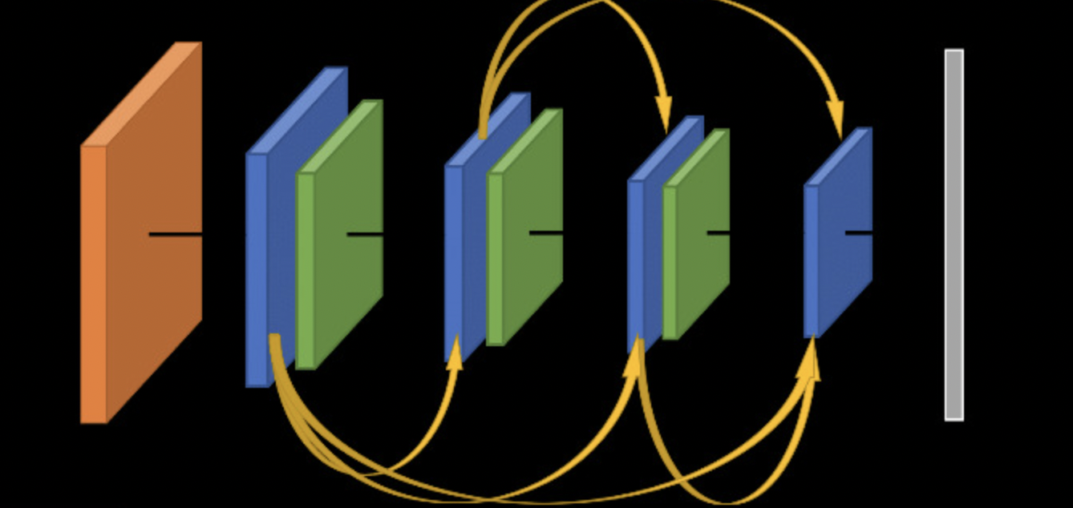
MODELS DESCRIPTION
1.Dense Net Architechture: So dense net is densely connected-convolutional networks. It is very similar to a ResNet with some-fundamental differences. ResNet is using an additive method that means they take a previous output as an input for a future layer, & in DenseNet takes all previous output as an input for a future layer as shown in the image.

Slide 7
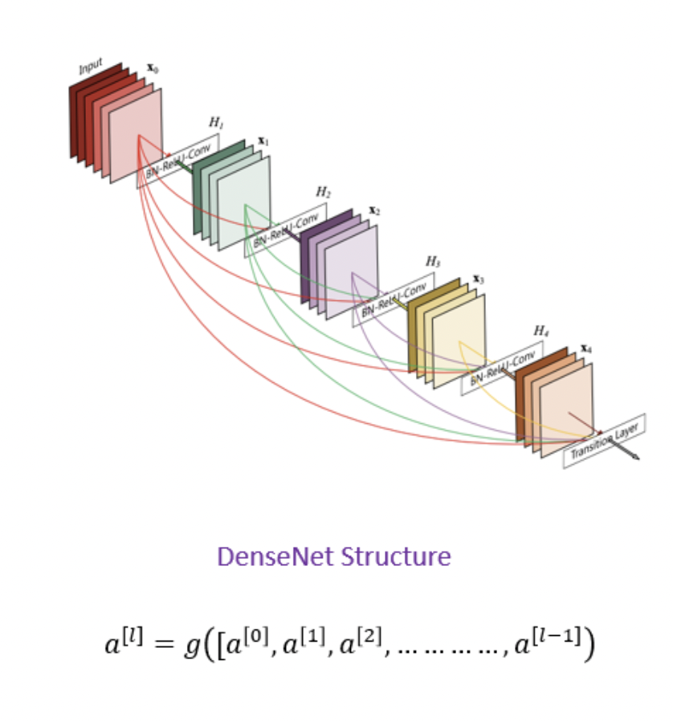
So DenseNet architecture was specially developed to improve accuracy caused by the vanishing gradient in high-level neural networks due to the long distance between input and output layers & the information vanishes before reaching its destination.

Slide 8
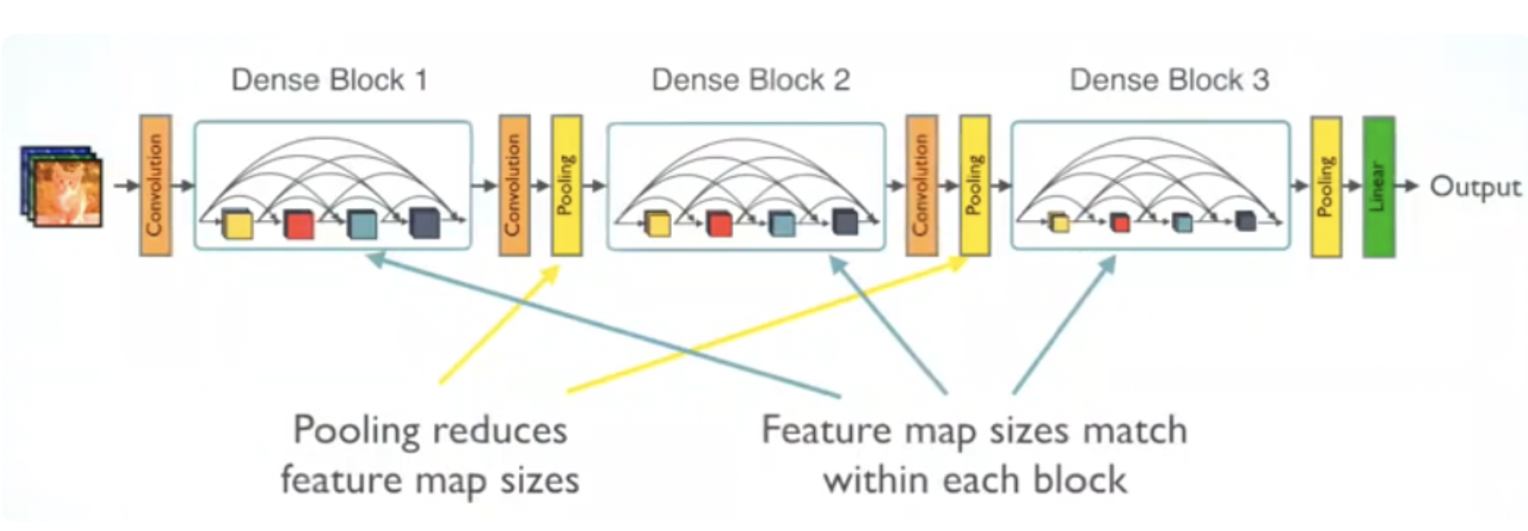
DENSE BLOCK AND LAYERS:

Slide 9
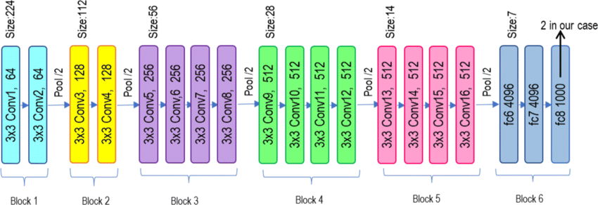
2.VGG-19 Model: Architecture:VGG19 is a variant of VGG model which in short consists of 19 layers (16 convolution layers, 3 Fully connected layer, 5 MaxPool layers and 1 SoftMax layer).

Slide 10
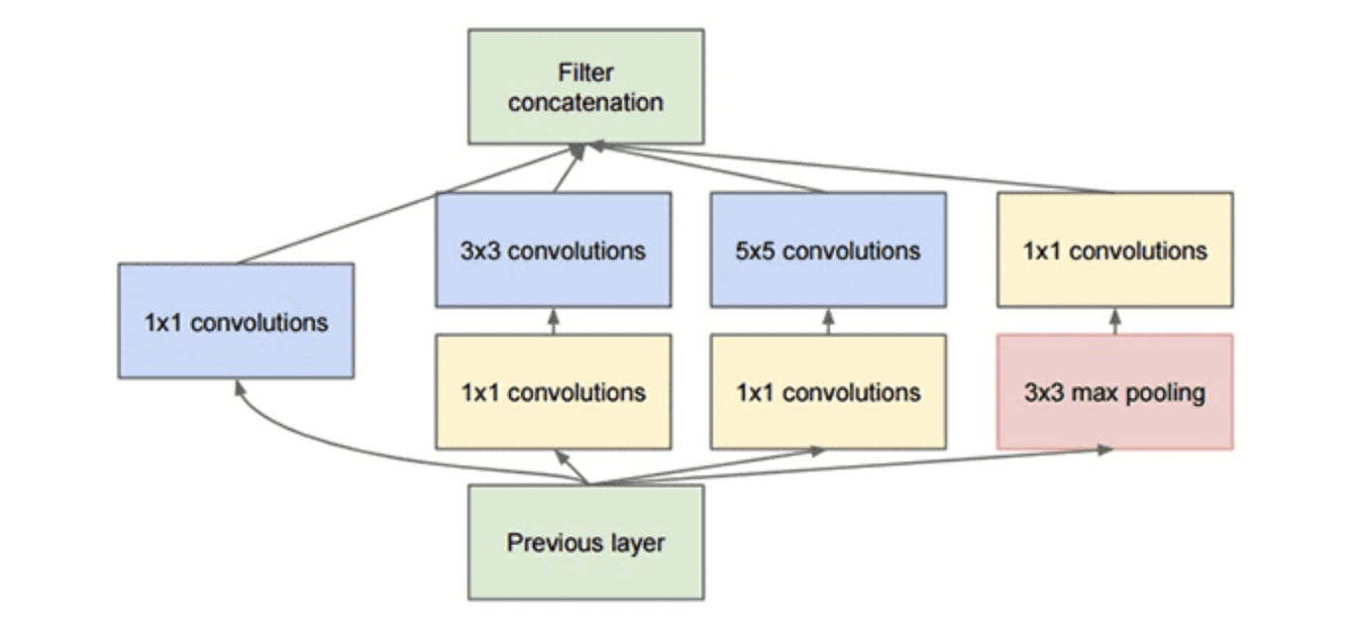
3.Customised Pretrained Inception model Architecture:
The goal of the inception module is to act as a “multi-level feature extractor” by computing 1×1, 3×3, and 5×5 convolutions within the same module of the network — the output of these filters are then stacked along the channel dimension and before being fed into the next layer in the network.

Slide 11
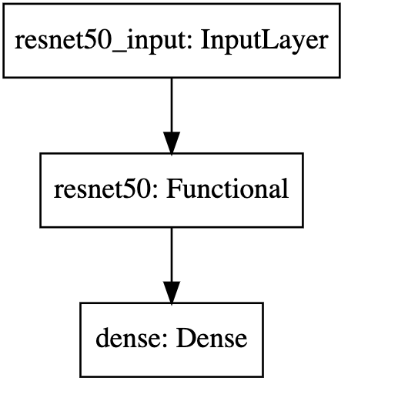
4.Transfer Learning Approach Architecture:
In this transfer learning approach, a pretrained ResNet50 model, initialized with ImageNet weights, is used as the base model.
The top layers are excluded, and a new dense layer with softmax activation is added to classify into the specified number of classes (NUM_CLASSES).
The base ResNet50 model is set to be trainable, allowing fine-tuning. The model is compiled with an SGD optimizer and a categorical cross-entropy loss with label smoothing. The model is then trained on the training data with a validation split to monitor performance.

Slide 12
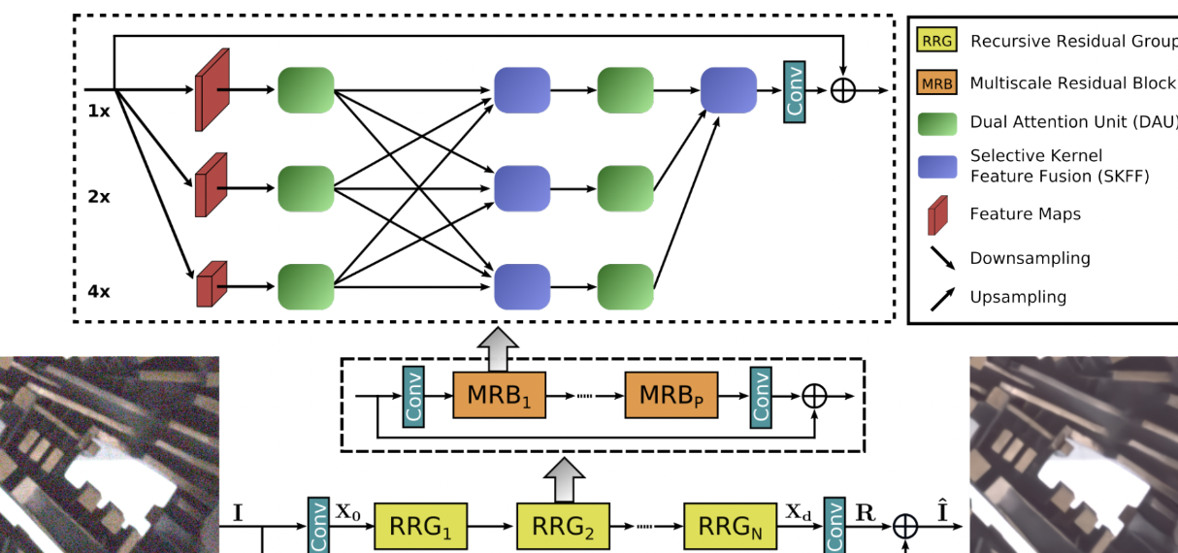
5.MIRNet Architecture:
A feature extraction model that computes a complementary set of features across multiple spatial scales, while maintaining the original high-resolution features to preserve precise spatial details.
A regularly repeated mechanism for information exchange, where the features across multi-resolution branches are progressively fused together for improved representation learning.

Slide 13
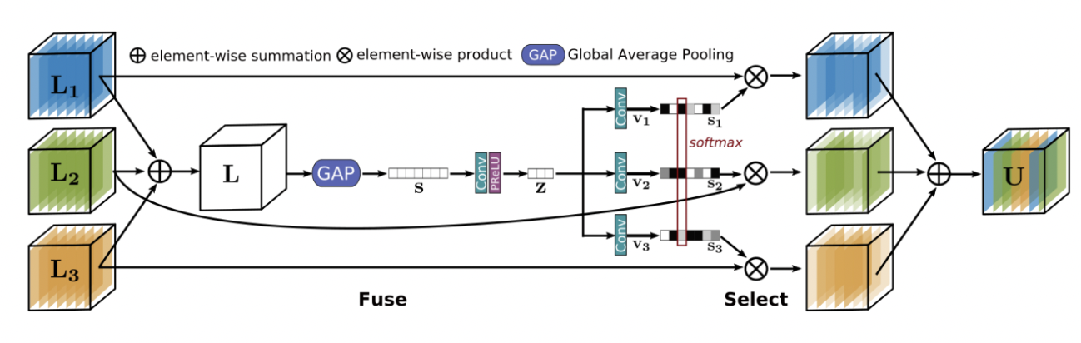
A new approach to fuse multi-scale features using a selective kernel network that dynamically combines variable receptive fields and faithfully preserves the original feature information at each spatial resolution.
A recursive residual design that progressively breaks down the input signal in order to simplify the overall learning process, and allows the construction of very deep networks.
Selective Kernel Feature Fusion:
The Selective Kernel Feature Fusion or SKFF module performs dynamic adjustment of receptive fields via two operations: Fuse and Select

Slide 14
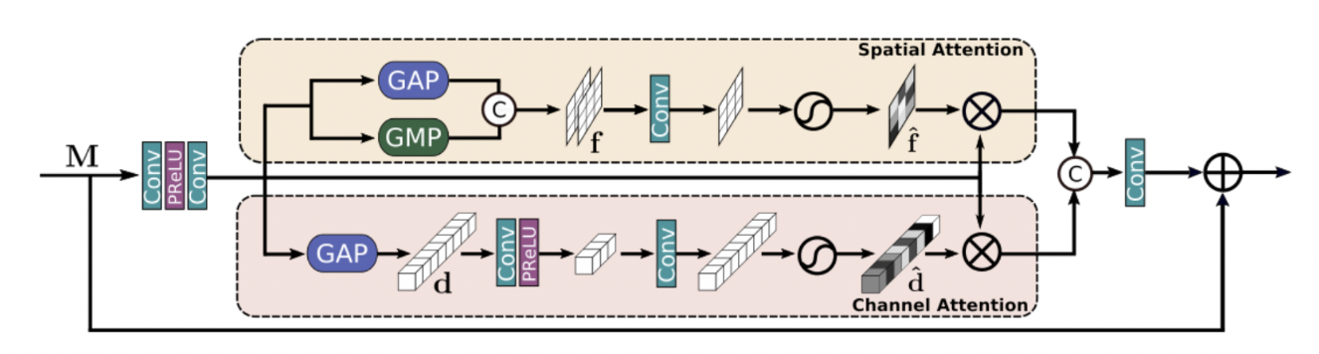
Dual Attention Unit:
The Dual Attention Unit or DAU is used to extract features in the convolutional streams. While the SKFF block fuses information across multi-resolution branches, we also need a mechanism to share information within a feature tensor, both along the spatial and the channel dimensions which is done by the DAU block.
The DAU suppresses less useful features and only allows more informative ones to pass further. This feature recalibration is achieved by using Channel Attention and Spatial Attention mechanisms.

Slide 15
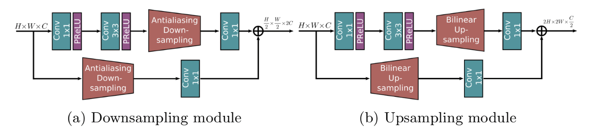
Multi-Scale Residual Block:
The Multi-Scale Residual Block is capable of generating a spatially-precise output by maintaining high-resolution representations, while receiving rich contextual information from low-resolutions. The MRB consists of multiple (three in this paper) fully-convolutional streams connected in parallel.

Slide 16
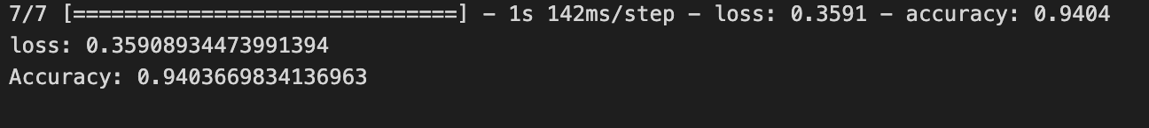
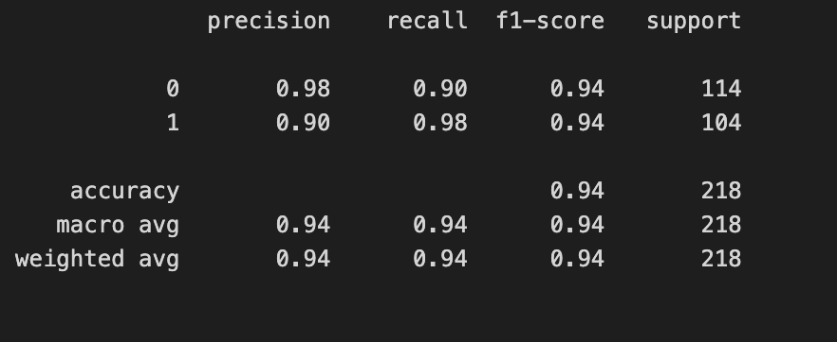
RESULTS AND DISCUSSIONS:
1.DENSE NET
CLASSIFICATION REPORT

Slide 17
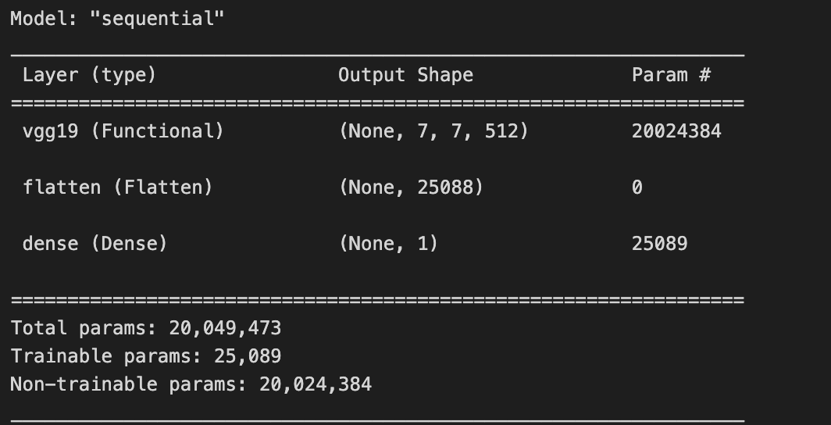
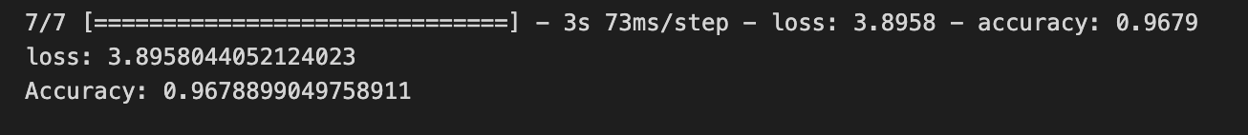
2.VGG 19:

Slide 18
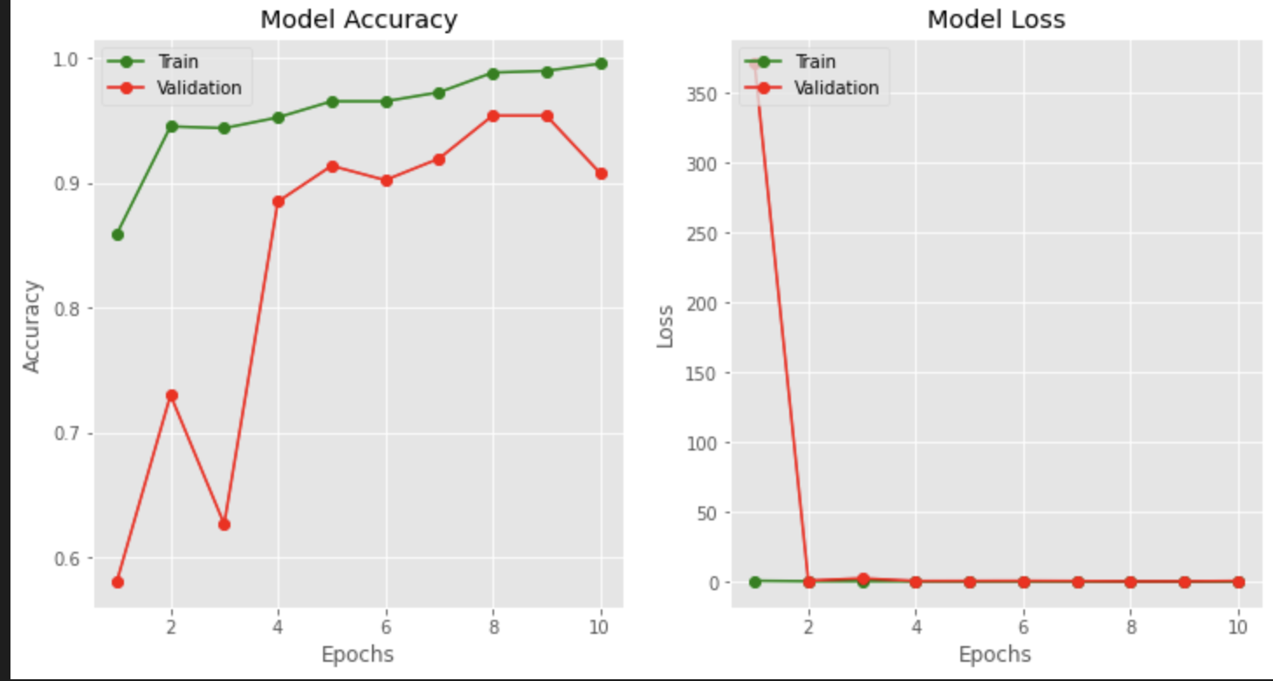
3.Customised Pretrained Inception:

Slide 19
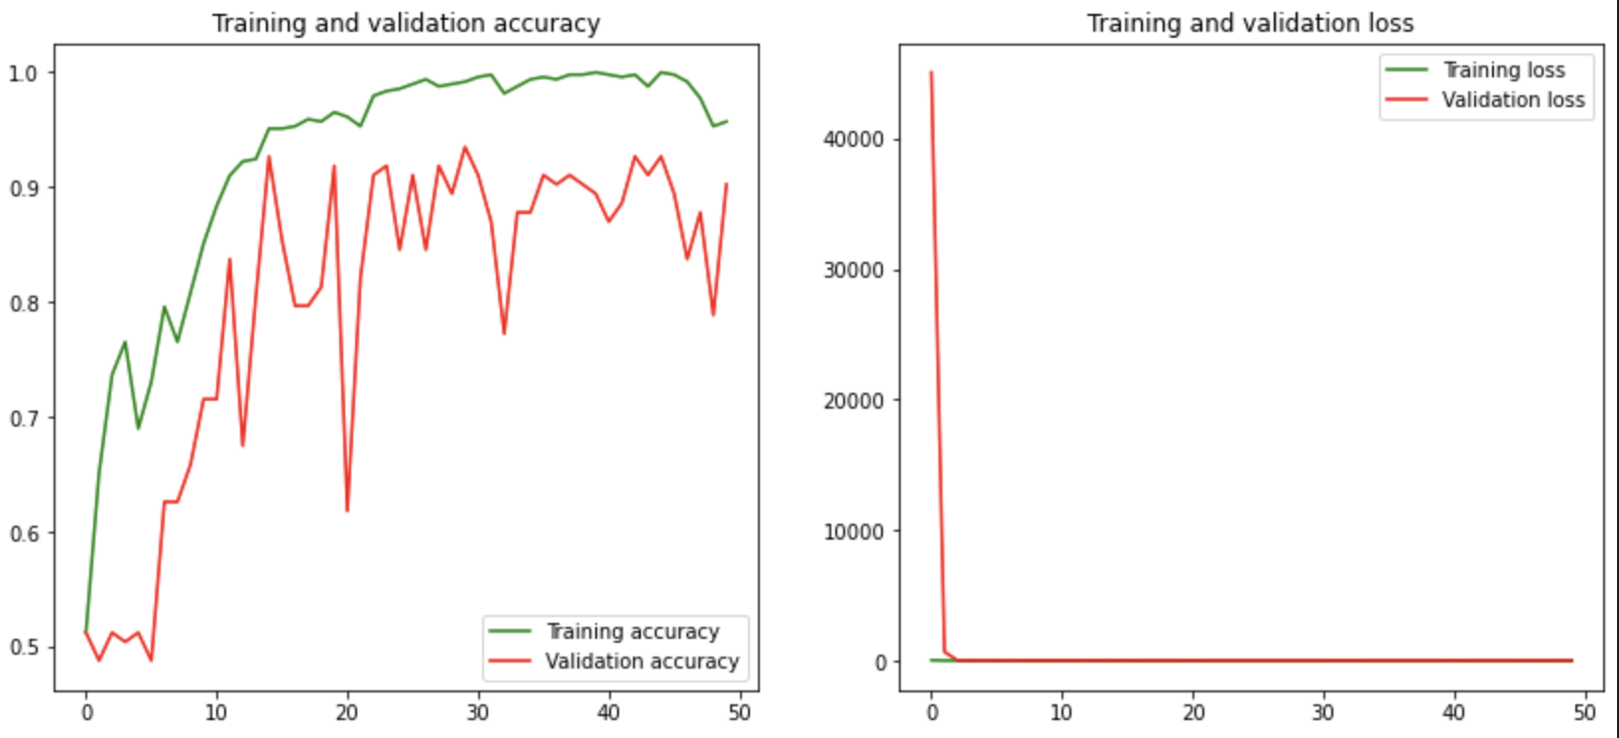
4.Transfer Learning:

Slide 20
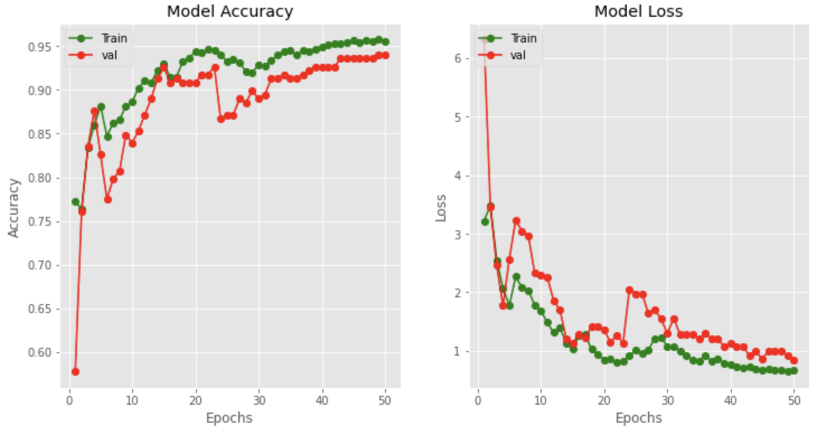
5.MIRNet Results

Slide 21
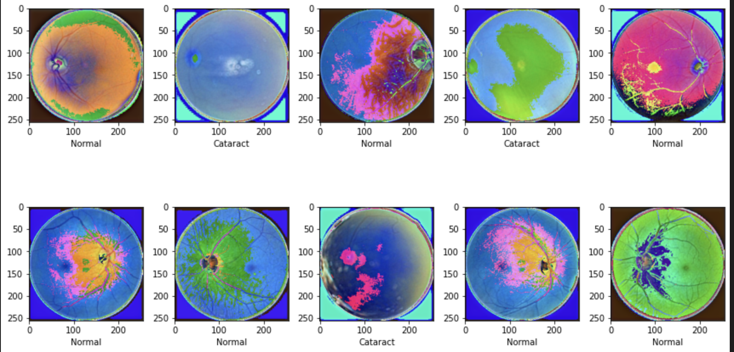
Improved image quality, enhancing the performance of other models when used as a preprocessing step.

Slide 22
Conclusion:
Performance Comparison: Through extensive experimentation, the DenseNet, VGG19, Inception, ResNet50, and MIRNet models were evaluated for their effectiveness in ocular disease recognition. ResNet50 and DenseNet demonstrated superior accuracy and robustness, outperforming the other models in detecting various ocular diseases from retinal images.
Model Efficiency: The use of transfer learning with pretrained models significantly improved the training efficiency and accuracy, showcasing the benefits of leveraging existing knowledge for medical image analysis.
Fine-Tuning Benefits: Fine-tuning the pretrained models allowed for better adaptation to the specific characteristics of the ocular disease dataset, enhancing the models' diagnostic capabilities

Slide 23
Future Directions:
Model Enhancement: Further research can focus on enhancing model architectures and incorporating advanced techniques such as attention mechanisms to improve diagnostic accuracy.
Larger Datasets: Expanding the dataset with more diverse and comprehensive retinal images can help in training more robust models capable of handling a wider range of ocular diseases.
Real-World Implementation: Collaborating with healthcare institutions to deploy and validate these models in real-world clinical settings will be crucial for transitioning from research to practical application.
Multi-Modal Approaches: Combining retinal images with other diagnostic data (e.g., patient history, genetic information) can lead to a more holistic approach to ocular disease diagnosis, improving overall effectiveness.

Slide 24
THANK YOU

